Slide 1


PROJECT FENIKS
Part 2: Feniks Rising
Week 18
28.02.2019

Slide 2
Feniks was set up in 2007 as a charity supporting integration and aiming at improving the wellbeing of the Central Eastern European Community in Edinburgh.
They are looking to improve the efficiency of record keeping, resource allocation and data analysis.
The previous cohort started this project, creating online forms from the paper versions currently in use. They learned how to use AWS and wrote documentation for the next groups to follow.

Slide 3
The Original Brief
Change the background image

Slide 4
The Updated Brief
Change the background image
Use e25’s documentation and code to learn how to use Amazon Web Services, specifically Lambda Functions, API Gateway and dynamoDB
Replicate their work on a new Amazon account, recreating the functions, gateway routes and db
Expand on this by completing full CRUD functionality
Improve UX of the website
Expand on documentation for the next group to use

Slide 5
What is Amazon Web Services?
Amazon Web Services (AWS) provides on-demand cloud computing platforms. The technology allows subscribers to have at their disposal a virtual cluster of computers, available all the time, through the Internet.

Slide 6
Ok, but what does that actually mean?
It means customers can set up websites and services without needing to host their own databases or servers to do so. It also means everything is automatically backed-up, and kept extremely secure by Amazon’s own security protocols.

Slide 7
Learning to use AWS: What did we need to do?
Create a NoSQL database using Amazon DynamoDB
Create lambda functions using AWS Lambda
Create a RESTful API gateway using AWS API Gateway

Slide 8
What is an AWS Lambda function?
A Lambda function is a piece of code that runs in the cloud in response to an event.
In our program, the event will be the request from the front end passed into the API gateway. To enable full CRUD we created the following Lambda functions.
Create One Client
Get One Client
Get All Clients
Update One Client
Delete One Client

Slide 9
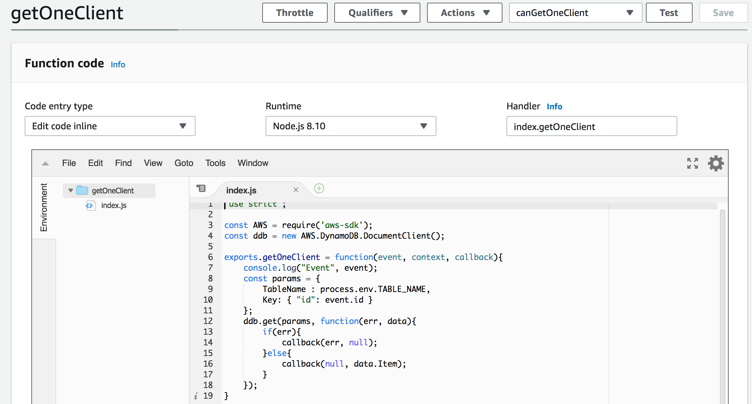
Example of an AWS Lambda function

Slide 10
The AWS API Gateway
We had to create an API using the AWS API Gateway. Within this we had to create a method for each lambda. Once this was done we had to enable CORS on the API and then deploy it.
Once the API has been deployed, we could then go back and run tests on the lambda and on the API (all within AWS).
Once the tests have passed, we could then hook up the front end!
Notes:
CORS - Cross Origin Resource Sharing

Slide 11
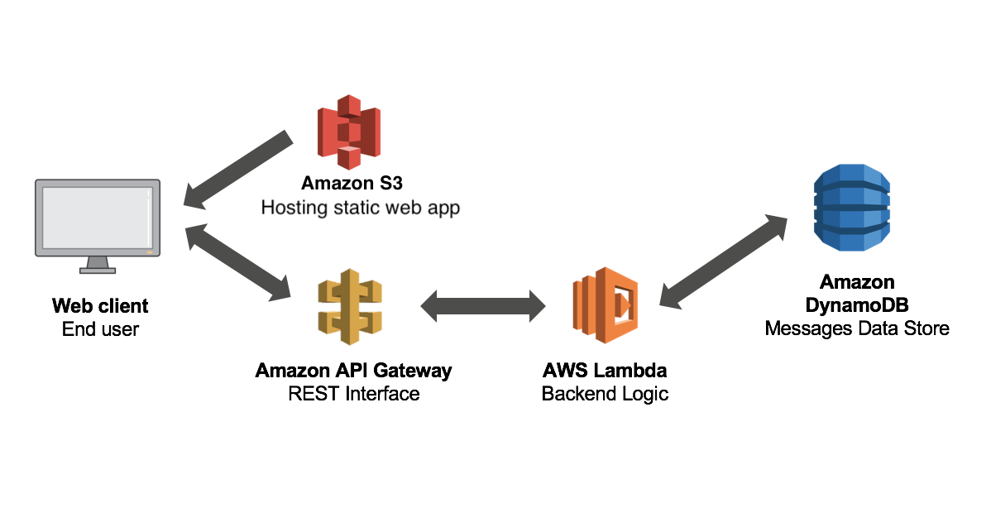

Slide 12
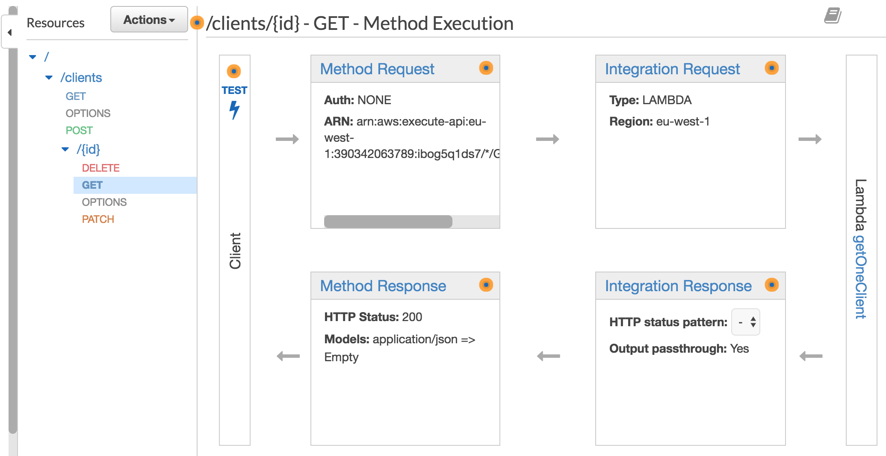
Example of an API Gateway

Slide 13
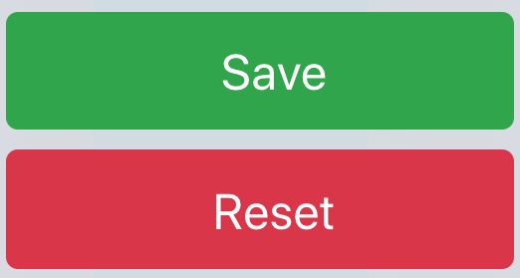
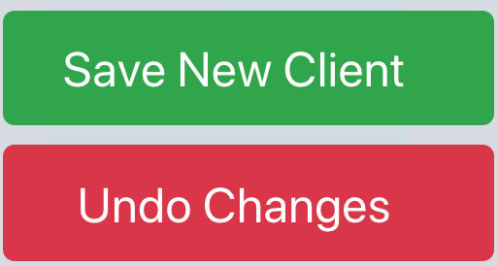
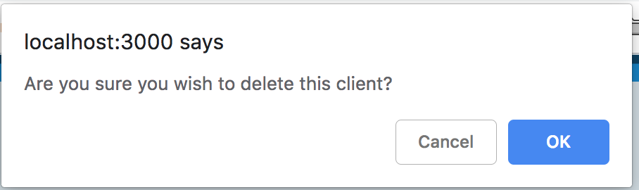
Examples of UX Changes
We changed the names of the buttons to make them more meaningful for end users:
->
We added a warning message if deleting a client:

Slide 14
Demonstration!
Notes:
Show:
Adding a new client Editing a client
Deleting a client
Search function

Slide 15
Challenges!

Slide 16
REGION!

Slide 17
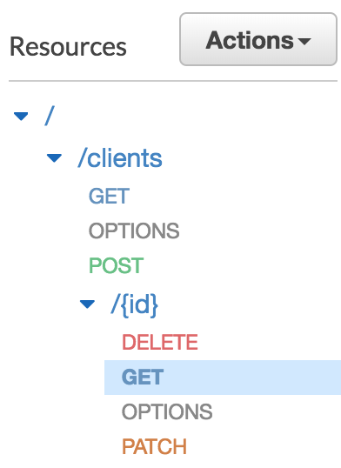
API Gateway Resource
In the API Gateway, we had to remember to create our methods on the correct resource.

Slide 18
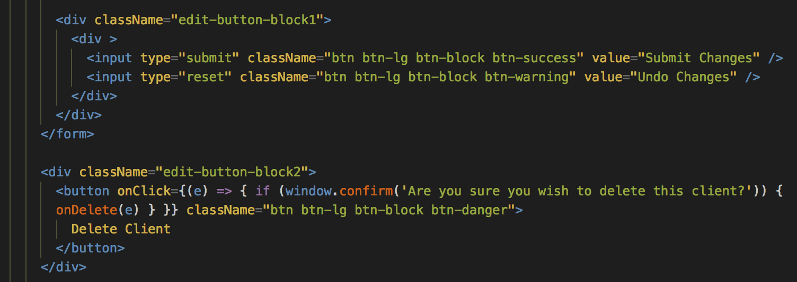
Delete Button problem

Slide 19
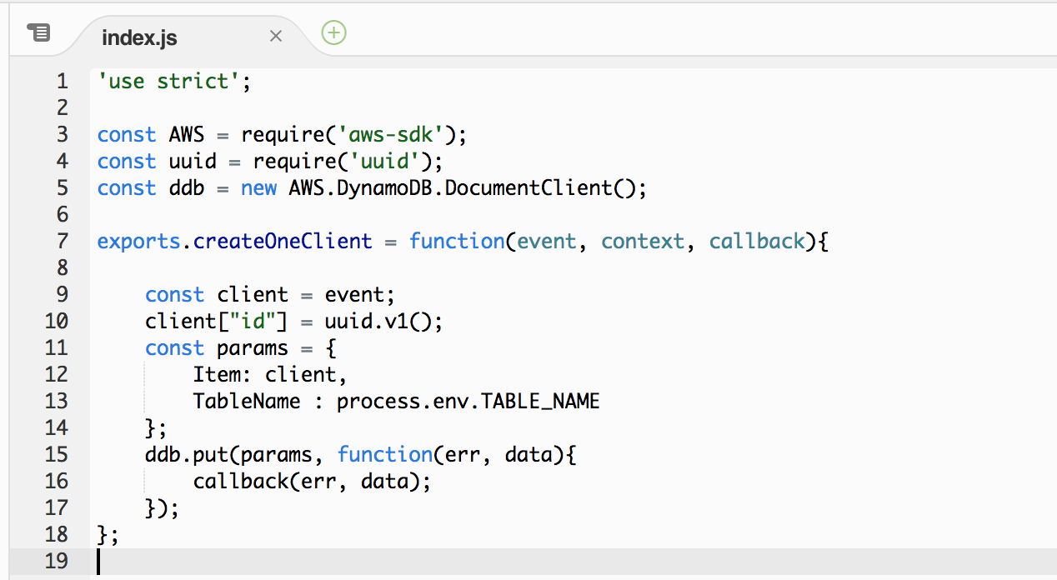
What are we proud of? Refactoring!
We reduced the createOneClient lambda that we inherited from 54 lines to 18!

Slide 20
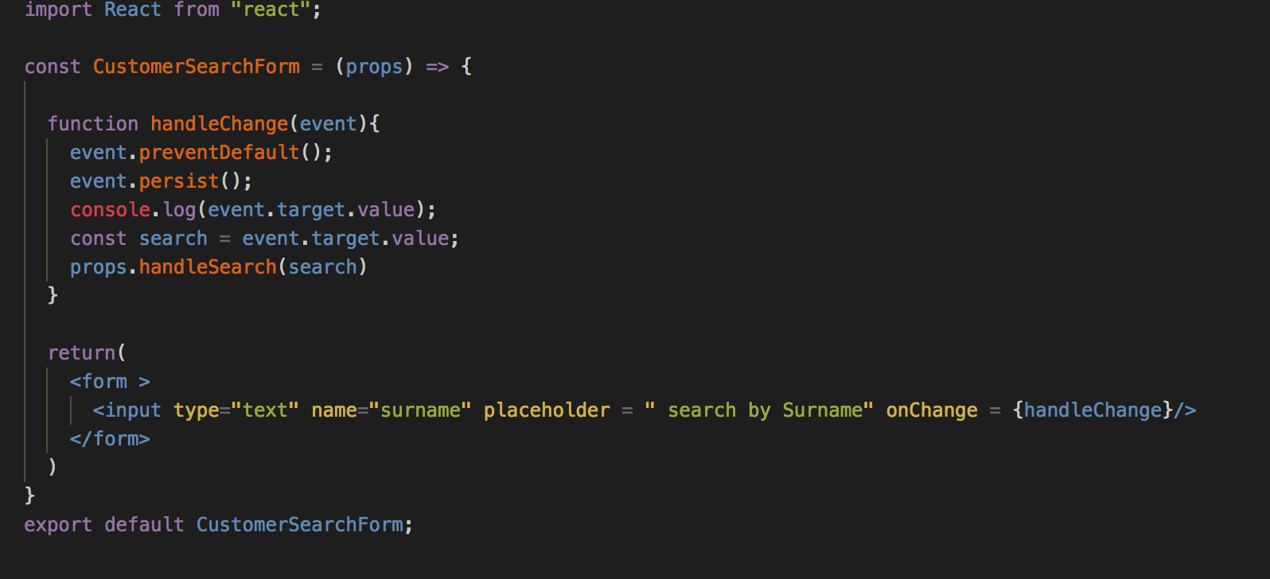
What are we proud of? Search!
We decided to have a crack at making a search function, but we’d been warned that this may be more complicated than we expected, so we were not really confident that we’d be able to do it in time. We knocked it out in a few hours!

Slide 21
What did we learn?
AWS is huge and intimidating, but we learned not to be (too) afraid, and there’s a lot of documentation available
Lambdas are not as confusing as they sound
Delete buttons don’t go in forms
How to be adaptable: team members were constantly applying for jobs, interviewing, and preparing for interviews, so we had to work around this.

Slide 22
What would we do if we had more time (or, what does the next group have to do?)
Implement user access control
Allow clients to be moved from Unassigned to another category by a drag and drop method
Create a db table and front-end to track the Equalities form statistics
Create db table for Client Assessment form and hook up to front-end

Slide 23
Questions?

